Slide 1
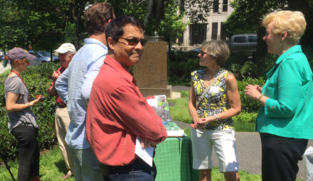
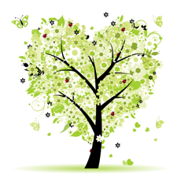
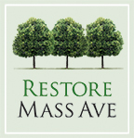
Love
Our Trees
Tour
Guided tour of trees in Emmet Park & 2400 block of Mass Ave
May 24, 2016
Tour given by RMA President
Deborah Shapley
Tour organizer: Debbie Rider
Above: Getting started in Emmet Park
Trees on the tour were planted in yards of several embassies, by Restore Mass Ave with Casey Trees starting in 2008. Tourgoers also saw sidewalk “street trees” we care for. As all these trees mature, the restored Grand Avenue landscape begins to be visible. Stats on next-to-last slide.

Slide 2
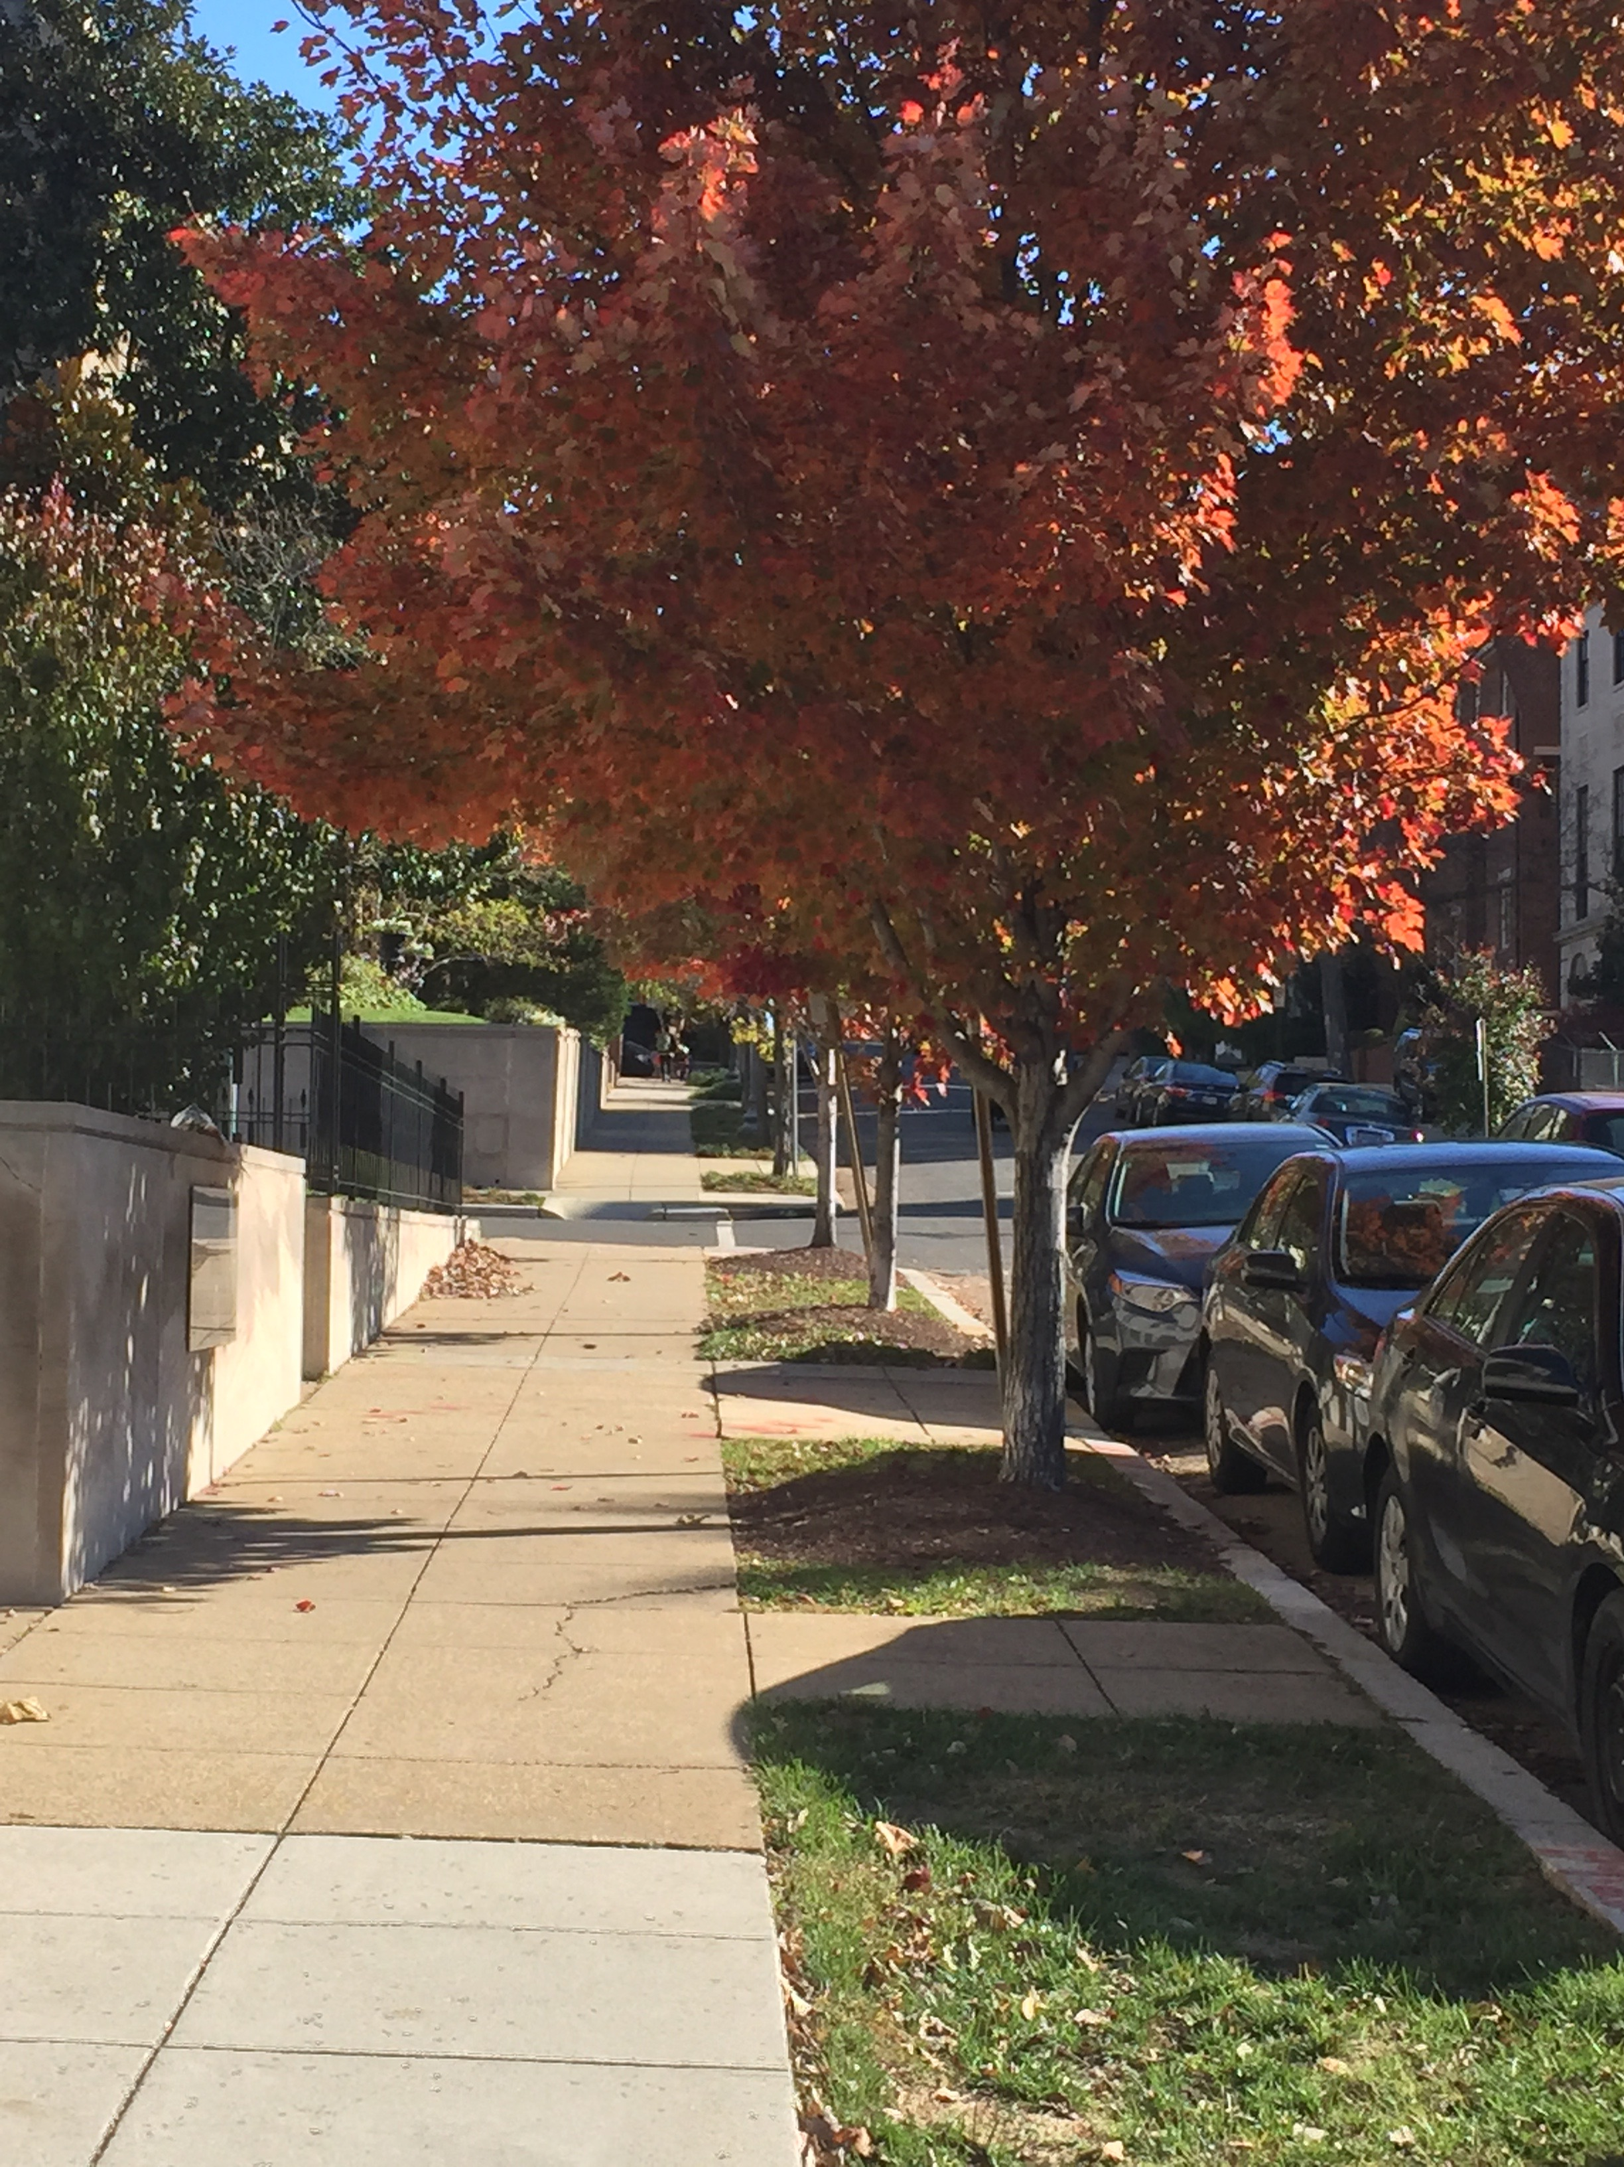
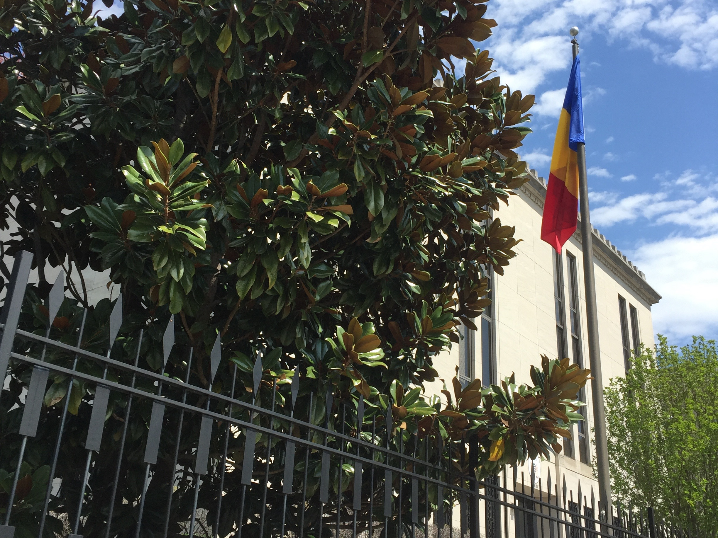
Embassy of Chad
2401 Mass Avenue at corner of S Street
At left is one of three southern magnolias the Chad Embassy planted in 2010 to complement its renovated building. At right on the S Street sidewalk, three ‘Red Sunset’ red maples make a cloud of brilliant color in fall. The Chad Embassy lovingly maintains all these trees.
Love Our Trees Tour
May 24, 2016

Slide 3
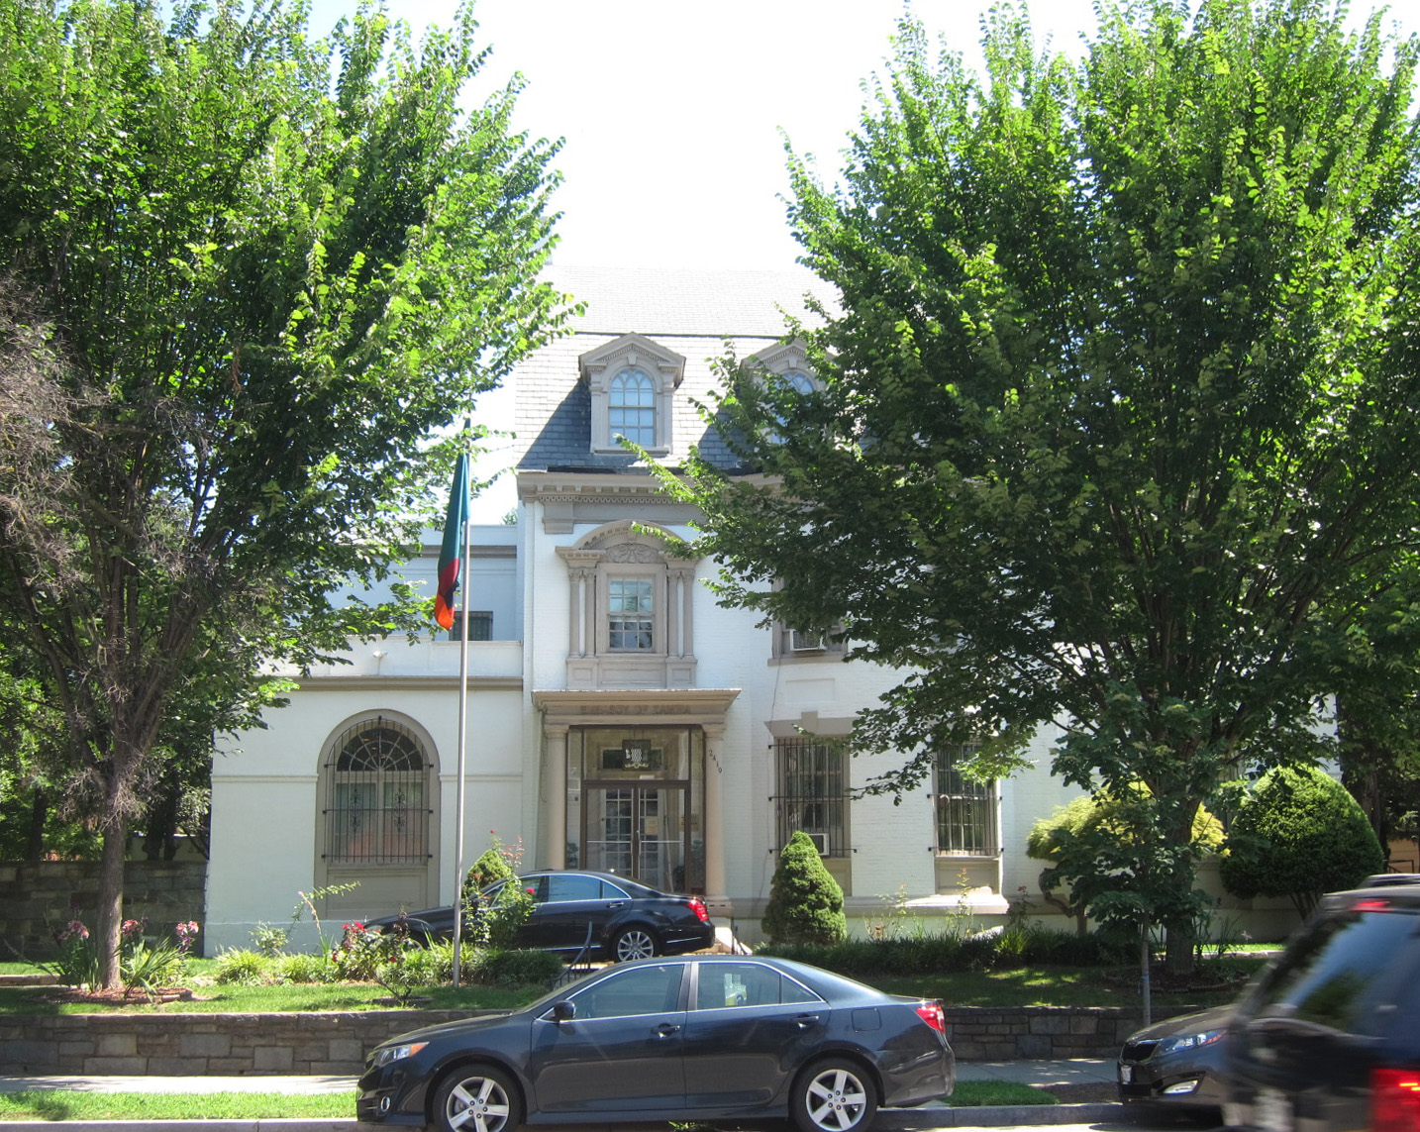
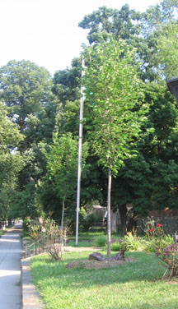
Embassy of Zambia
2419 Mass Ave
Four American elms
form a “second row” inside the sidewalk.
2009 2015
Love Our Trees Tour
May 24, 2016

Slide 4
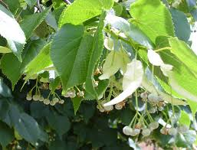
Linden = historic Grand Avenue tree
Tilia, known as linden or basswood, was popular in European cities. Unter den linden boulevard in Berlin was the model for Mass Ave’s double rows of American lindens >100 years ago. Today several linden varieties are planted along its sidewalks to recreate the colors, forms and lovely scent of the original Grand Avenue.
Linden leaf, bract and drupe (fruit) drawn by Polly Alexander* and on Mass Ave sidewalk.
* Credit on last slide.
Love Our Trees Tour
May 24, 2016

Slide 5
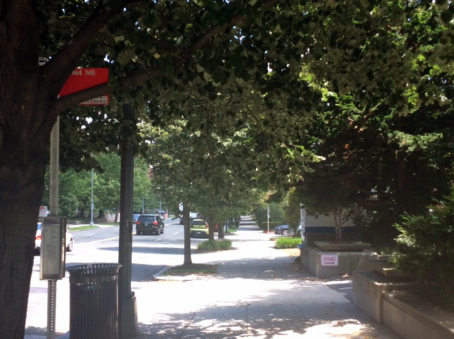
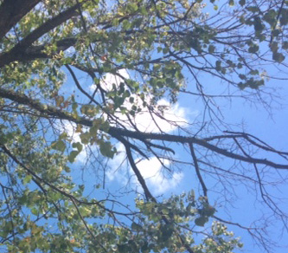
Linden “street trees”
Right: Lindens planted next to the street are cared for well by Venezuela Residence (2444 Mass), Embassy of Korea (2450 Mass), Embassy of Côte d’Ivoire (2424 Mass).
Left: Bare upper branches show that this old linden is failing.
Love Our Trees Tour
May 24, 2016

Slide 6
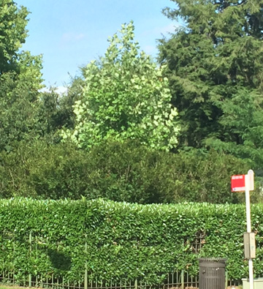
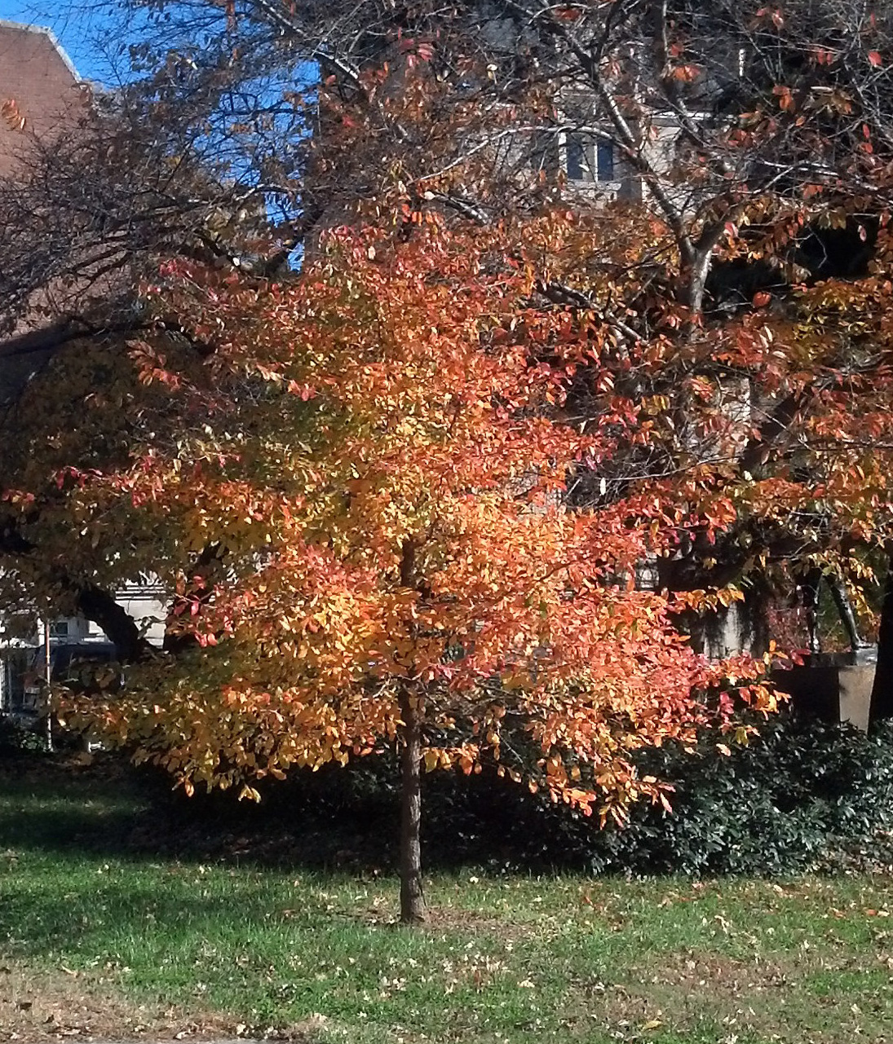
Prominent Trees for Triangle Views
.
Tulip poplar at corner of California St & Mass Ave (Venezuela Residence).
Black gum we planted at S St and Mass Ave (Emmet Park).
Love Our Trees Tour
May 24, 2016

Slide 7
Summary
.
This tour:
20 second row trees planted by RMA since 2008
elm, linden, black gum
35 other yard trees arranged by RMA
southern magnolia, swamp oak, Chinese elm
35 sidewalk “street trees” planted by DC Urban Forestry Administration
various linden types, also maple and elm
.
The Big Picture:
RMA’s program on Embassy Row, =2 miles of Mass Ave from Dupont Circle to Wisconsin Avenue, has achieved
330 new trees including >170 DC “street trees” plus >150 trees in yards, including >70 second row trees. RMA promotes care for the ~1,000 trees
on this route. We hope to be a model for achieving urban forest benefits
And to provide Inspiring civic views in the 21st century.
Love Our Trees Tour May 24, 2016

Slide 8
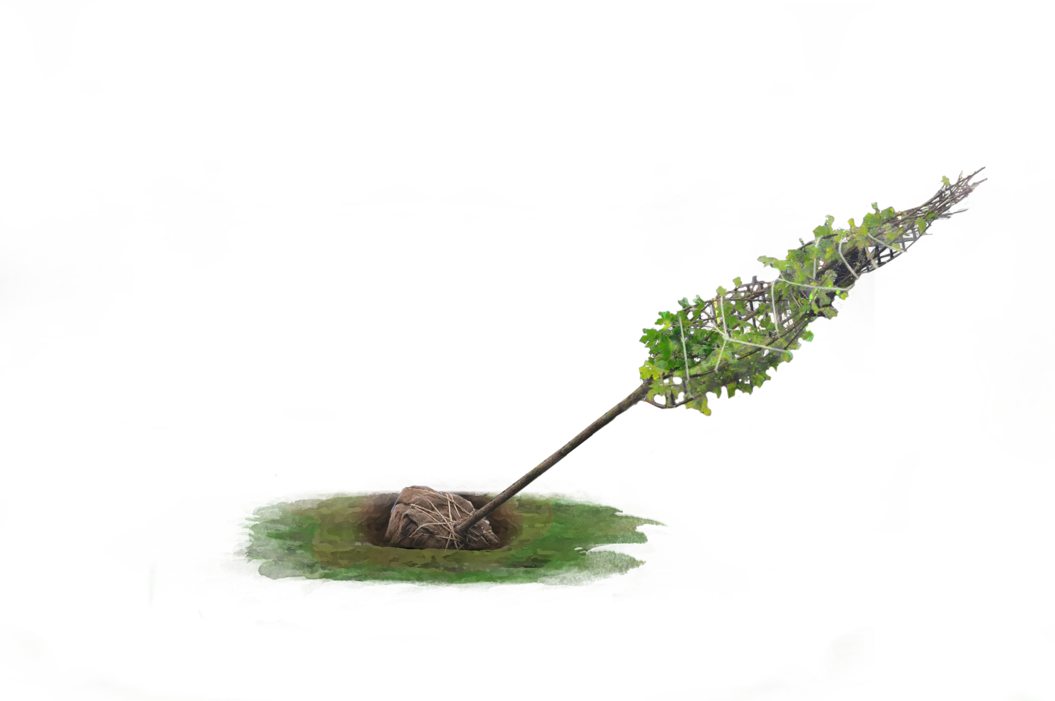
Thank you !
.
We PARTICIPANTS in the RMA program. These embassies have
added trees and care for trees In the 2400 Block of Mass:
Cameroon
Netherlands
Chad
Zambia
Marshall Islands
Venezuela – Residence
PARTNERS: Casey Trees, DC Urban Forestry Administration. Ricky Fuentes (Professional Gardens), Alexander Barnett (Empirical Lands), Jose Majano (Majano Landscaping), DCA Landscape Architects. SPECIAL THANKS: RMA Treekeepers and Board of Directors.
Korea
Algeria - Residence
Côte d’Ivoire
United Arab Emirates
Paraguay
*All images are RMA except linden drawing from City of Trees: The Complete Field Guide to the Trees of Washington DC by Melanie Choukas-Bradley, Illustrations by Polly Alexander, University of Virginia Press, Third Edition, 2008.
Love Our Trees Tour
May 24, 2016

